Slide 1

DriverPass System Analysis
Sharif Ayesh
Notes:
[No speaker notes required for this slide.]

Slide 2

System Requirements
Functional Requirements:
User Authentication: The system must allow users to securely register, log in, and manage their accounts.
Data Storage & Retrieval: Users should be able to store, retrieve, and modify their data efficiently within the system.
Nonfunctional Requirements:
Security: To prevent unauthorized access, the system must encrypt sensitive user data and comply with security best practices.
Performance: The system should handle at least 1000 concurrent users without significantly decreasing response time.
Notes:
Every system needs a clear set of requirements to ensure it meets user expectations. Here, we have two categories: functional and nonfunctional requirements.
Functional requirements describe what the system must do. First, user authentication allows individuals to create accounts and securely log in. Second, data storage and retrieval ensure users can save and access their information whenever needed.
Nonfunctional requirements define the system’s quality and performance. Security is a top priority, so we use encryption and protective measures to keep data safe. Additionally, the system must handle at least 1,000 users at a time without slowing down, ensuring a smooth experience.
These requirements ensure the system remains secure, efficient, and user-friendly for our client

Slide 3
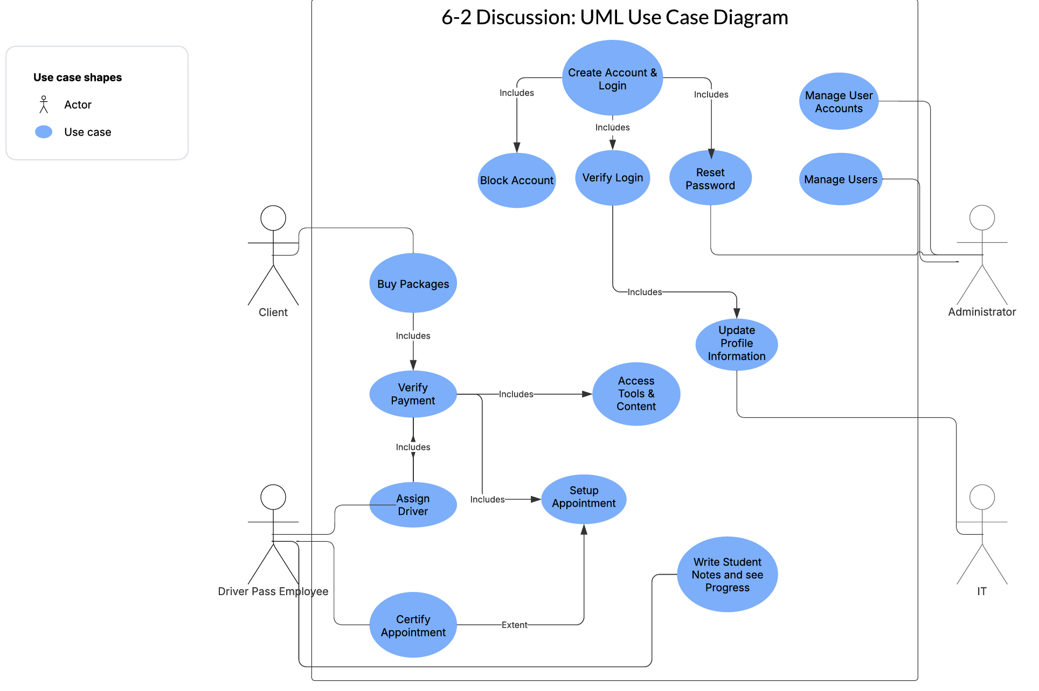
Use Case Diagram
Notes:
This diagram represents how different people interact with the system to accomplish tasks. The system is designed to meet the needs of various users, including clients, administrators, IT personnel, and employees handling appointments.
Clients can create accounts, log in, and manage their profiles. They can also purchase packages, verify payments, and book appointments. Employees are responsible for assigning drivers and certifying appointments to ensure a smooth process. Administrators handle user management and profile updates, ensuring the system remains organized and efficient.
The design ensures that DriverPass’s needs are met by streamlining account management, booking processes, and verification tasks. This setup makes the system easy to use, reducing time spent on manual operations while improving service efficiency.

Slide 4
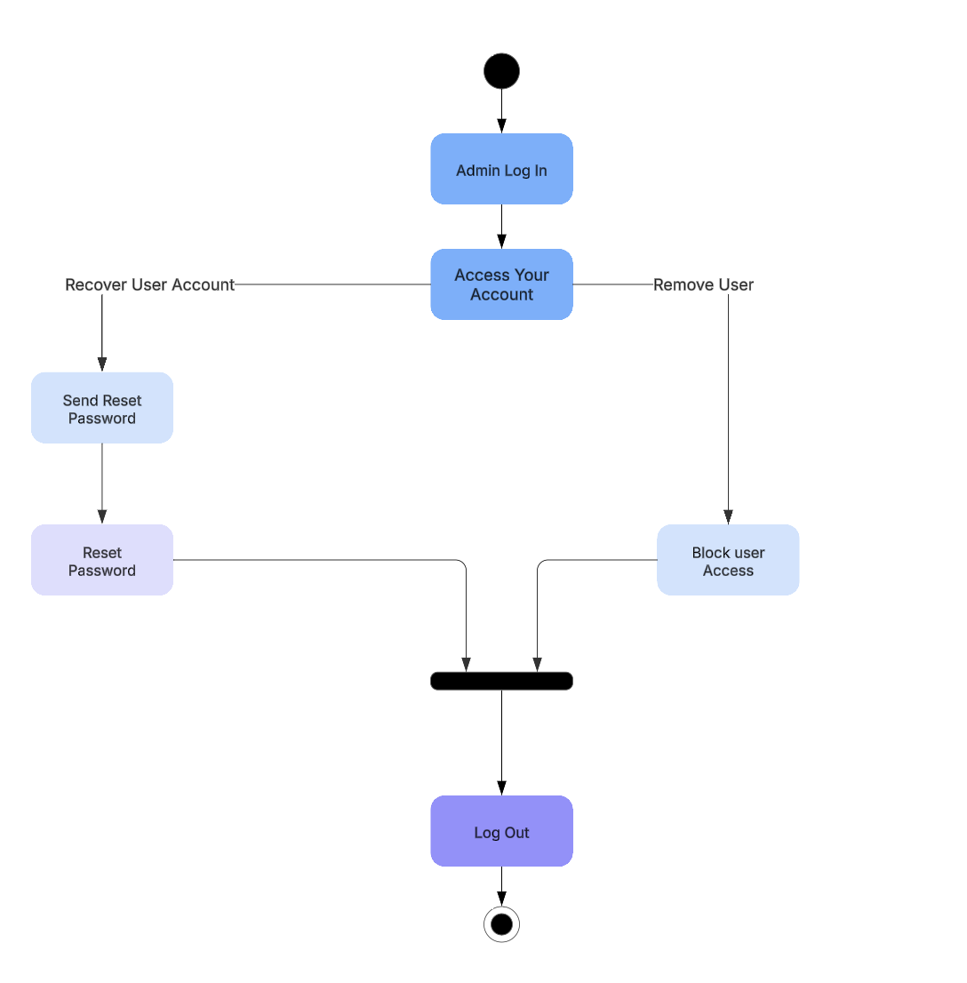
Activity Diagram
Notes:
This diagram represents the step-by-step flow of actions for managing user accounts in the system. It outlines key activities, such as logging in, accessing an account, recovering a password, and blocking user access.
When an administrator logs in, they can either manage user accounts or remove access if necessary. If a user needs to recover their account, the system sends a reset password request, allowing them to update their credentials. Once these actions are completed, the process concludes with logging out.
This structure ensures a smooth and efficient workflow for both user account recovery and administrative actions, making account management secure and easy to use.

Slide 5
Security
Performance Constraints: The system may experience slowdowns with heavy usage or large data loads.
Scalability Issues: Expanding the system to accommodate more users or new features might require significant upgrades.
Security Risks: The system may have vulnerabilities that need regular updates to prevent cyber threats.
Compatibility Limitations: Some features may not work on all devices or operating systems.
User Experience Challenges: The interface might have a learning curve or require improvements for better accessibility.
Data Storage Restrictions: Limited capacity could impact data retention and require external solutions.
Network Dependency: The system's performance may depend on a stable internet connection.
Notes:
Security is a top priority in our system design to protect user data and maintain a safe environment. We have taken multiple steps to ensure that the system remains secure and reliable.
First, user authentication ensures that only authorized users can log in, preventing unauthorized access. Sensitive data is encrypted, meaning even if someone intercepts it, they cannot read it. Access control adds another layer of protection by restricting certain actions based on user roles, so only administrators can make changes to accounts.
Additionally, regular system updates will help patch security vulnerabilities and keep the system up to date. Lastly, we have monitoring and alert systems in place to detect and respond to any suspicious activity quickly.
These security measures help build trust with users, ensuring their data and interactions remain protected at all times.

Slide 6
System Limitations
Internet Dependency: The system requires a stable internet connection to function properly, limiting use in areas with poor connectivity.
Limited Offline Capabilities: Users may have restricted access to features when not connected to the internet, reducing efficiency in offline scenarios.
Scalability Constraints: Expanding the system to support more users or additional functionality may require significant resources and infrastructure upgrades.
User Training Required: Some features may have a learning curve, requiring training for users to fully utilize the system.
Security Risks: The system may be vulnerable to cyber threats, requiring regular updates and security protocols to protect data.
Notes:
While our system offers many advantages, there are some limitations to consider. First, the system is highly dependent on an internet connection. If a user experiences connectivity issues, they may not be able to access certain features.
Additionally, offline capabilities are limited, meaning users must be online to perform most tasks. As the system grows and more users join, scalability constraints may require infrastructure upgrades to maintain smooth performance.
Another challenge is user training. Since this system introduces new workflows, some users may need guidance to fully utilize its features. Lastly, while we have implemented strong security measures, no system is completely immune to cyber threats, so continuous monitoring and updates are necessary to maintain protection.
Understanding these limitations allows us to plan for improvements and ensure a better experience for all users.

